Slide 1

RAGHU ENGINEERING COLLEGE(Autonomous) Department of Electrical & Electronics Engineering
Academic Year : 2021- 2022 IV Year II-Semester ZERO REVIEW OF PROJECT
PROJECT
ON
AUTONOMOUS POWER MANAGEMENT FOR INTERLINKED AC-DC MICROGRIDS
Batch No:08
K.Diwakar 19985A0231
M.Anjali 19985A0242
T.Sai Ganesh 19985A0290
Y.Dileep Prudhvi 19985A0298
Project Guide:
Mr. P. Srinivas
Assistant Professor

Slide 2
MAIN OBJECTIVE
The main objective of this proposed scheme is to control the flow of power from AC micro grid to DC micro grid whenever there is peak load demand or the contingency condition by keeping in view of the specific loading condition of the DC micro grid.
It will also reduces the number of tie converters used by adopting the prioritized system unlike the other power management control strategies.

Slide 3
ABSTRACT
The existing power management schemes are either concerned about power sharing or regulation of voltage but not on both.
But the proposed scheme will enable us to regulate the voltage on the basis of specific loading condition of the DC micro grid.
The proposed scheme will also enable us to transfer power from AC micro grid to DC micro grid during the peak load demand or at contingency condition.
The results reveal the usefulness of the proposed scheme in the power management and then results are verified through MATLAB/SIMULINK environment.

Slide 4
INTRODUCTION
The proposed scheme will enable us autonomous power transfer between the AC micro grid and DC micro grid.
This will enable the management of power only when one micro grid is heavily loaded and another micro grid is lightly loaded.
Their network topologies and control strategies are mainly determined to maximize the benefits while meeting the load requirements.
The deployment of these new technologies in the form of a micro grid is preferred due to several advantages, such as optimal utilization of resources, improved power quality and enhanced supply reliability

Slide 5
LITERATURE SURVEY
By enabling of AC micro grids in distributed network will increase the performance and reliability of the electrical system.
This is mainly devoted to minimize the operation cost, coordinating support services and also to maximize the reliability and controllability of micro grids.
A single stage inverter system with maximum power point tracking control (MPPT) which is applicable in low power photo voltaic (PV) energy conversion systems is proposed in this project.
The proposed system is successfully implemented by using a single digital signal processor TMS320F2808.

Slide 6
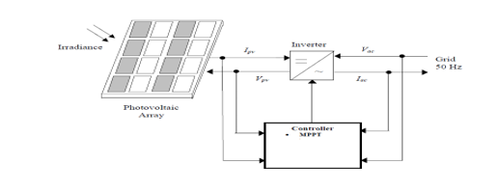
PV RENEWABLE SOURCES
The usage of solar cells to transform energy from solar irradiance through electricity is really a process that renewable support.
The main reason for the fluctuation with PV systems production capacity is the seasonal variation of solar irradiance which is due to the passing of clouds across a PV field.

Slide 7
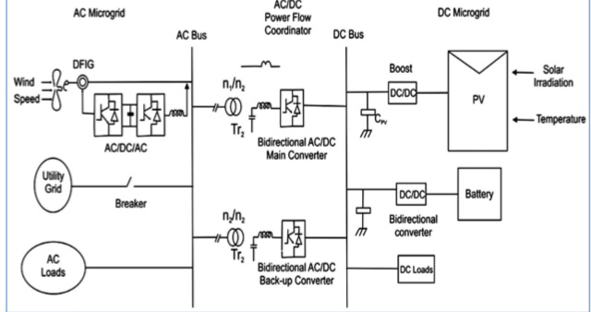
BLOCK DIAGRAM

Slide 8
REFERENCES
J. Rocabert, A. Luna, F. Blaabjerg, and P. Rodr´ıguez, “Control of power converters in AC microgrids,” IEEE Transactions on Power Electronics, vol. 27, no. 11, nov-2011
M. Liserre, T. Sauter, and J. Y. Hung, “Future energy systems: integrating renewable energy sources into the smart power grid through industrial electronics,” IEEE Industrial Electronics Magazine, vol.4. no. 1, pp. 18–37, Mar. 2010.
M. Tsili and S. Papathanassiou, “A review of grid code technical requirements for wind farms,” IET Renewable Power Generation, vol. 3, no. 3, pp. 308–332, Sep. 2009.
T. Strasser, F. Andren, J. Kathan, C. Cecati, C. Buccella, P. Siano, P. ´ Leitao, G. Zhabelova, V. Vyatkin, P. Vrba, and V. Ma ˜ ˇ r´ık, “A review of architectures and concepts for intelligence in future electric energy systems,” IEEE Transactions on Industrial Electronics, vol. 62, no. 4, pp. 2424–2438, Apr. 2015.
A. Kwasinski, “Quantitative evaluation of dc microgrids availability: Effects of system architecture and converter topology design choices,” IEEE Transactions on Power Electronics, vol. 26, no. 3, pp. 835–851, Mar. 2011.

Slide 9
THANK YOU

